Slide 1


SocialBuzz Content Performance Analysis

Slide 2


Today's agenda
Project recap
Problem
The Analytics team
Process
Insights
Summary

Slide 3

The client is SocialBuzz, a social media and content creation company based in San Fransisco. The company was established in 2010.
They have scaled quicker than anticipated and need the help of an advisory firm to oversee their scaling process effectively. They are looking to bring in external expertise to handle the large amount of data.
In this 3 month initial project, they are expecting the following:
An audit of their big data practice
Recommendations for a successful IPO
An analysis of their content categories that highlights the top 5 categories with the largest aggregate popularity
Project Recap

Slide 4

Problem
Over 100,000 contents per day ranging from text, images, videos, and GIFs.
More than 36,5 million contents per year. This signifies rapid growth and massive data volume.
How to use the data to increase user engagement? Analysis of the top 5 most popular content categories, top contents, and monthly content performance.

Slide 5



Andrew Fleming
Chief Technical Architect
The Analytics team
Marcus Rompton
Senior Principle
Giselle Halim
Data Analyst

Slide 6
Process
1
Project and Data Understanding
2
Data Cleaning
3
Data Analysis
4
Data Visualizations
5
Insights and
Recommendations

Slide 7


Tools Used
Microsoft Excel
Microsoft PowerBI

Slide 8
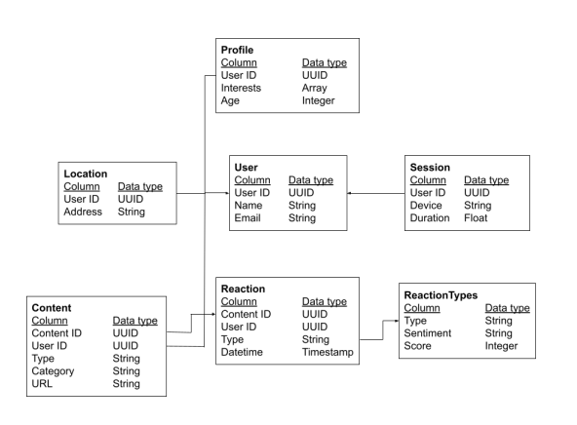
Project and Data Understanding
Start by understanding the business goals and diving deep into the data's origins and structure.
The goal is to gain insight from the data in order to increase user engagement.
The dataset contains 24529 rows with the following columns:
Category (16 different categories)
Content ID (unique content ID)
Category Type (audio, video, photo, GIF)
Datetime (date and time)
Reaction Type (16 different reactions)
Score (popularity score based on reaction)
Sentiment (sentiment based on reaction)

Slide 9
Data Cleaning
Data cleaning is done to ensure data accuracy and consistency using tools like Excel formulas, and potentially restructure it for optimal analysis. This step includes searching for empty rows and deleting duplicate data.
Then, the clean dataset will be processed further to unleash the data's secrets through various analysis methods, revealing trends and patterns.

Slide 10

Insights
16
1897
May
Unique
Categories
Reactions to
“Animals” posts (Highest)
Month with the
most engagement

Slide 11
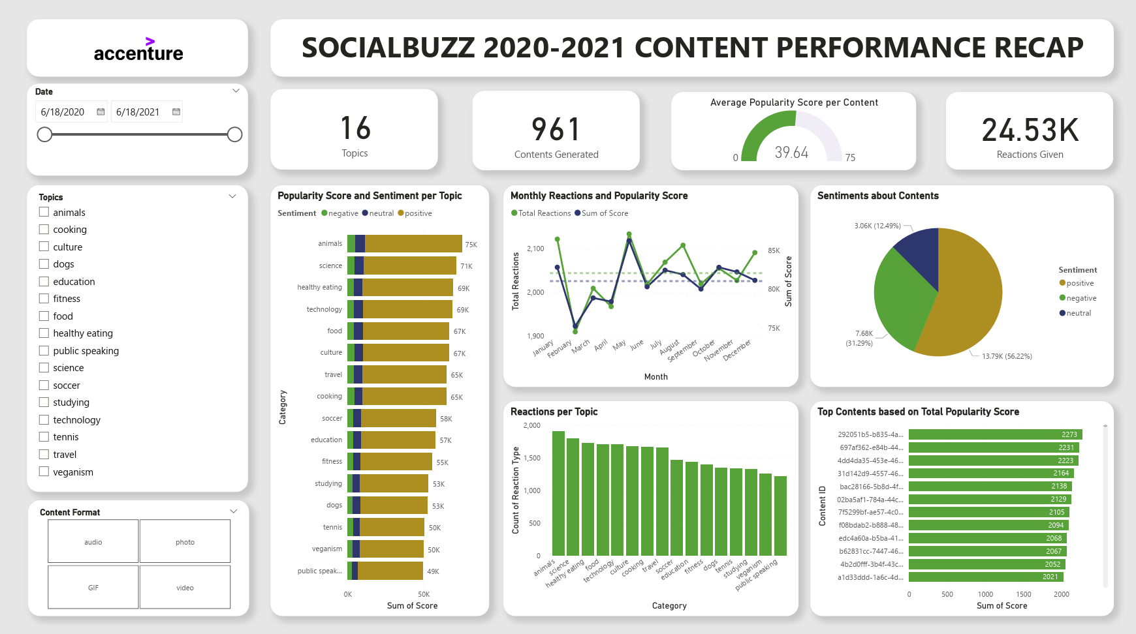

Slide 12

The most popular category, "animals" has 1897 reactions and 74965 total popularity score. The other top categories are “science”, “healthy eating”, “technology”, and “food”. Animals and science are the two most popular categories of content, showing that people enjoy "real-life" and "factual" content the most.
Summary
May 2021 was the month with the most post reactions with a total of 2134 reactions. Followed by January 2021 and August 2020.
The most popular post, "292051b5-b835-4a60-962a-bddf10da82bd" has 2222 total popularity score. Followed by “697af362-e84b-4429-b4ea-4123c6ab44ba” and “4dd4da35-453e-466d-95ca-b1a7710fac1f”.

Slide 13
Food is a common theme with the top 5 categories with "Healthy Eating" ranking the highest. This may give an indication to the audience within your user base. You could use this insight to create a campaign and work with healthy eating brands to boost user engagement.
Summary
Most of the content gains positive sentiment with an average popularity score of 39.64. This means that the post is generally positive.
This ad-hoc analysis is insightful, but it's time to take this analysis into large scale production for real-time understanding of the business.

Slide 14
Recommendation
Content about animals is clearly resonating with the audience, garnering the most reactions and the highest overall popularity score. This suggests an opportunity to focus on creating or showing more animal-themed content.
Analyze the most popular posts to understand what resonates with the audience. Look for common themes, formats, and approaches to enhance the app’s algorithm.
Don't neglect other high-performing categories like science, healthy eating, technology, and food. Consider creating or showing content that caters to these interests as well.
May appears to be the month with higher engagement, so create a plan to potentially capitalize on the trend.
Consider creator partnerships with creators who specialize in popular categories like animals, science, and healthy eating. This can help to expand reach and tap into new audiences.
Collaborate with relevant brands to create sponsored content that aligns with the audience's interests.

Slide 15
THANK YOU!
ANY QUESTIONS?

